Slide 1
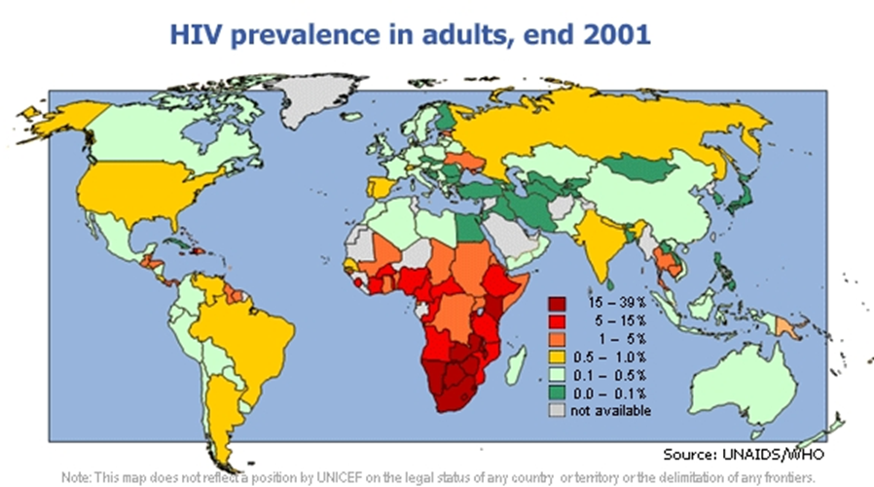
Lecture 11
RNA and DNA Retroviruses
HIV and beyond

Slide 2
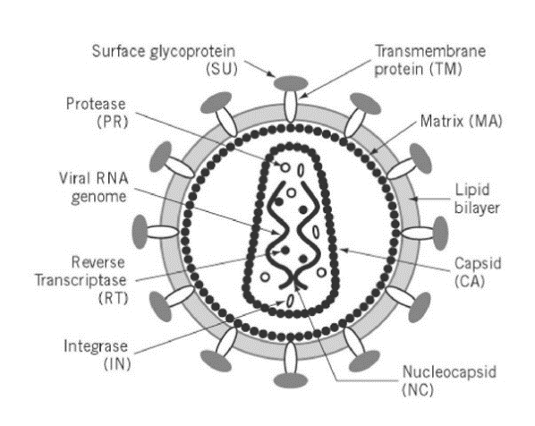
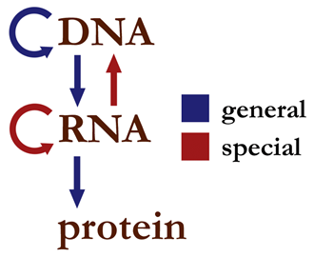

RNA retroviruses
Overview
• Defined by the production of reverse transcriptase and
its ability to convert viral genomic RNA into DNA
• General virion structure
- Genome: Single-stranded, positive sense RNA genome
- Always package two copies
- Needed for reverse transcription
- Resemble cellular mRNA → 5’ cap, 3’ poly A tail
- Coated w/ NC protein
- Simple retroviruses have three major regions genetically
- gag (encodes MA, CA, NC)
- pol (encodes PR, RT, IN)
- env (encodes glycoproteins)

Slide 3

RNA retroviruses
Overview
• General structure
- Capsid
- Cone-shaped capsid (CA) surrounds genome
- Also includes RT, PR, and IN inside w/ the genome
- Beyond the capsid
- Matrix (MA) protein and host-derived
envelope surround the capsid
- Envelope has a complex viral
glycoprotein composed of two
non-covalently linked polypeptides
- Called SU (surface) and TM (transmembrane)
- Has ability to mediate both attachment and fusion

Slide 4
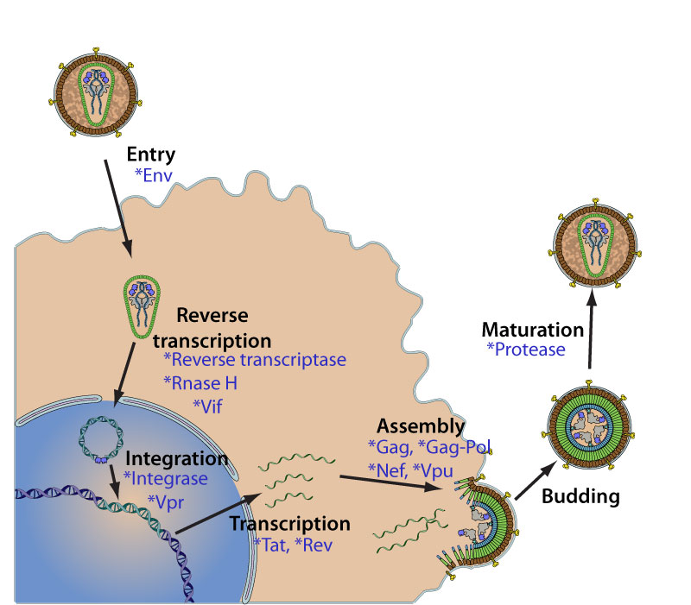
RNA retroviruses
Unique features of replication
• Entry is usually at the PM
- Combo SU-TM glycoprotein changes shape after binding
to the receptor
- SU attaches to receptor, TM mediates fusion w/ PM
• Uncoating and reverse transcription
- Most models → HIV uncoats
gradually on its way to the nucleus
- Capsid needed for movement to
nucleus on MF and MT
- Reverse transcription takes place
inside of the capsid
- Gone before reaching nuc pore

Slide 5
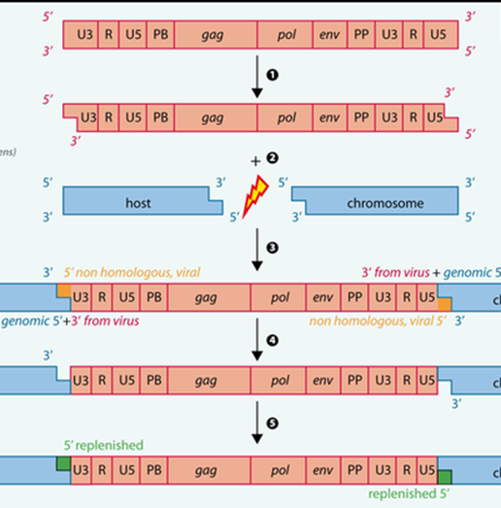
RNA retroviruses
Unique features of replication
• Nuclear entry and integration
- Pre-integration complex must form before nuclear entry
- PIC includes dsDNA viral genome, viral proteins (IN, Vpr,
RT, and PR) and some host proteins
- Nuclear entry occurs via 1 of 2 mechanisms:
- PIC actively moves through nuc pore
- Most require cell to be mitosis so that
nuclear membrane breaks down
- Integrase cuts host DNA at “random” sites
- Cuts 2 nt off each viral LTR and 2 nt off
host DNA → ends ligated and fixed
- Inserted genome called provirus

Slide 6
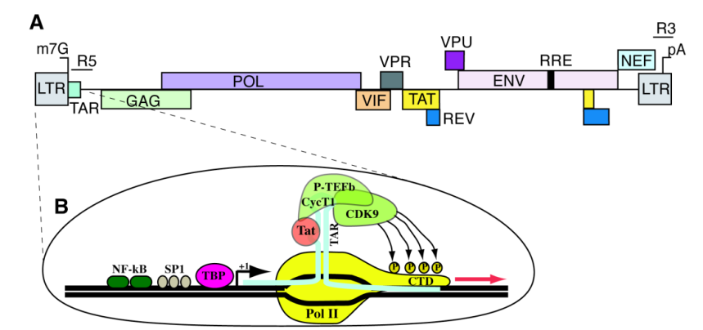
RNA retroviruses
Unique features of replication
• Transcription and genome replication
- Viral transcription factors bind to viral promoter found
in the upstream LTR region
- Turns on transcription of viral gag-pol-env genes by host
RNA pol (DdRp)
- Product of transcription is viral
mRNA (+ sense)
- Get a 5’ cap and 3’ poly A tail
- Some remain full-length and become new genomes
- Some are spliced into smaller mRNAs → new viral
proteins

Slide 7
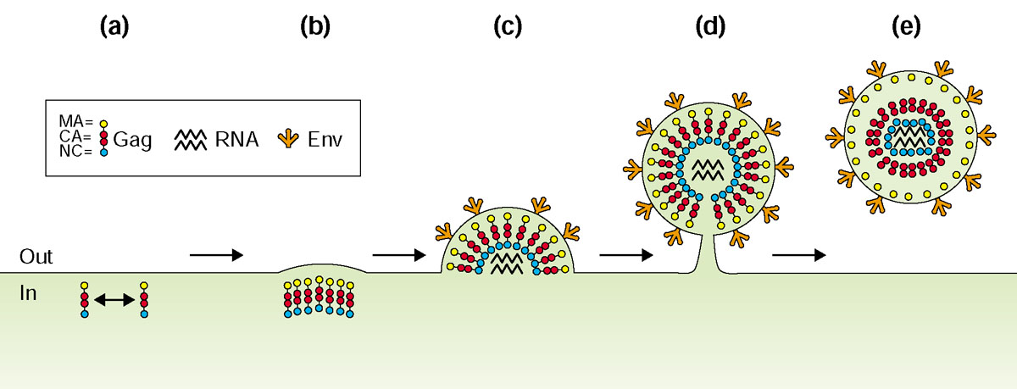
RNA retroviruses
Unique features of replication
• Assembly, budding, and maturation
- Gag and Gag-pol polyproteins go to the PM carrying two
copies of the + sense RNA genome
- Gag proteins aggregate together and begin pushing
membrane out
- Budding is ESCRT-dependent
- Protease cuts itself out and then cuts Gag and Gag-pol
into individual MA,
NC, CA, RT,SU, TM
proteins
- NC coats genome,
CA assembles into
the capsid,….

Slide 8


RNA retroviruses
Endogenous retroviruses
• Endogenous retroviruses (ERVs) overview
- Exogenous retroviruses invaded gamete-forming tissue
(sperm and eggs) and stayed in genome there
- Passed to next generation in gamete
- Usually defective → can’t produce virions anymore
- Abundant → Human genomes have >100,000 ERVs
- Found in most animals (humans, pigs, dogs,…)
• ERVs sometimes copy themselves and move to other parts
of the same genome
- Called retrotransposition
• ERVs can sometimes make actual virions
- If one lacks a gene, can be supplied by another

Slide 9
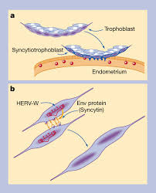
RNA retroviruses
Endogenous retroviruses
• ERVs and the animal placenta
- HERV Env proteins can be expressed in cells
- Some of these can cause two adjacent cells
to fuse with one another
- Creates syncytia
- Early development of mammalian placenta requires fusion
of trophoblast cells
- Recent evidence suggests the fusion uses HERV Env
- Did ERVs play a role in mammalian evolution?
- Virus Hunter video clip (25min – 33 min)
https://www.youtube.com/watch?v=xtnejNGOONk

Slide 10
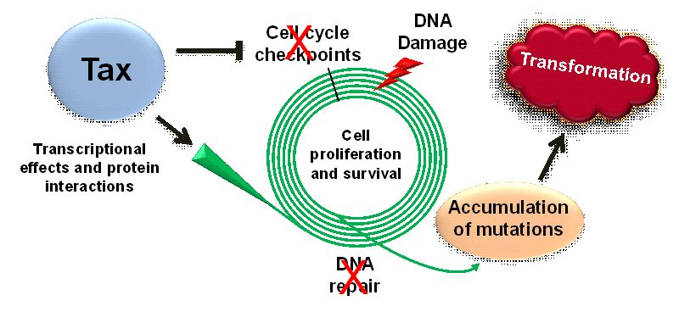
RNA retroviruses
HTLV-1 and 2
• Human T cell lymphotrophic viruses (HTLV)
- Rare in humans
- Type of complex retrovirus (more than gag-pol-env)
- Spread via sexual contact, blood, and breast-feeding
• HTLV-1 and 2 can cause significant human disease
- Adult T cell lymphoma and leukemia (ATL) – HTLV-1
- Slow progressing cancer of T cells that can take >40 yrs
- Cancerous T cells can be in bone marrow and blood
(leukemia) or in lymph nodes (lymphoma)
- Largely due to the production of viral Tax oncoprotein
- Tax turns on cell division, blocks p53, blocks cell death,
and inhibits DNA repair

Slide 11

RNA retroviruses
HTLV-1 and 2
• HTLV-1 and 2 can cause significant human disease
- Tropical spastic paraparesis (myelopathy)
- Release of cytokines from CTLs fighting infected cells
leads to inflammation and demyelination
- Causes chronic muscle weakness, spasms, and sensory
disturbances
- Immunodeficiency – due to T cell activation in wrong way
• HTLVs are way more common in tropical areas like Japan,
Caribbean, and Africa
• Infects mostly CD4+ helper T cells, but can also infect
CD8+ cytotoxic T cells

Slide 12
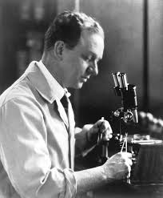
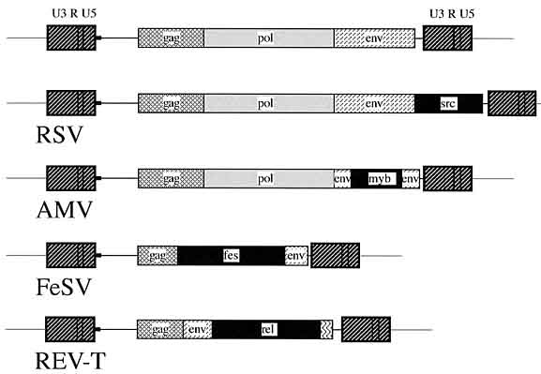
RNA retroviruses
Retroviral oncogenes
• First retrovirus found to cause cancer in
animals was Rous Sarcoma Virus (RSV)
- Discovered Peyton Rous 1911
- Chicken sarcoma virus passed through filter
• Mechanism of cancer induction by RSV (and others)
- Viral genome integrates into host
genome near a gene important for
cell division (proto-oncogene)
- Provirus decides to exit the host
genome at some point
- Accidentally grabs that cell division gene

Slide 13
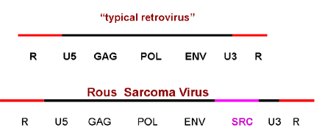
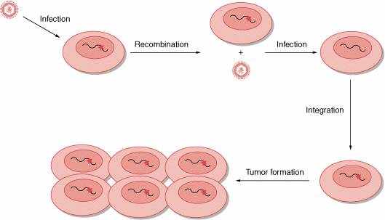
RNA retroviruses
Retroviral oncogenes
• Mechanism of cancer induction by RSV (and others)
- Virions created that have modified genome with cellular
gene inside it (a gene that controls cell division)
- That cellular gene can mutate to be ON all the time (now
called a viral oncogene)
- Virion infects a new cell
- Delivers the mutant cell division gene
- Cell immediately starts to replicate uncontrollably

Slide 14


RNA retroviruses
Some animal retroviruses
• Retroviruses can cause great harm to a variety
of animals
- Equine infectious anemia virus (EIAV)
- Transmitted by insects that bite an infected horse and by
medical equipment (e.g. needles) → very contagious
- Type of lentivirus like HIV
- Induces severe anemia → must quarantine or euthanize
- Feline leukemia virus (FeLV) and FIV
- Both retroviruses, but belong to different genera
- FeLV is extremely dangerous – causes pathology in a
large number of tissues and is spread by saliva
- FIV mimics HIV in its pathogenesis

Slide 15
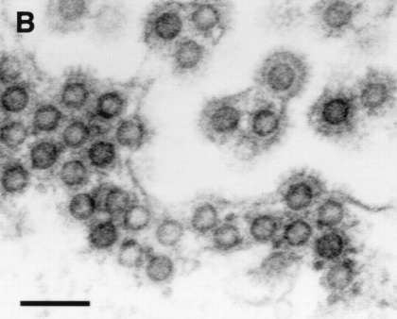
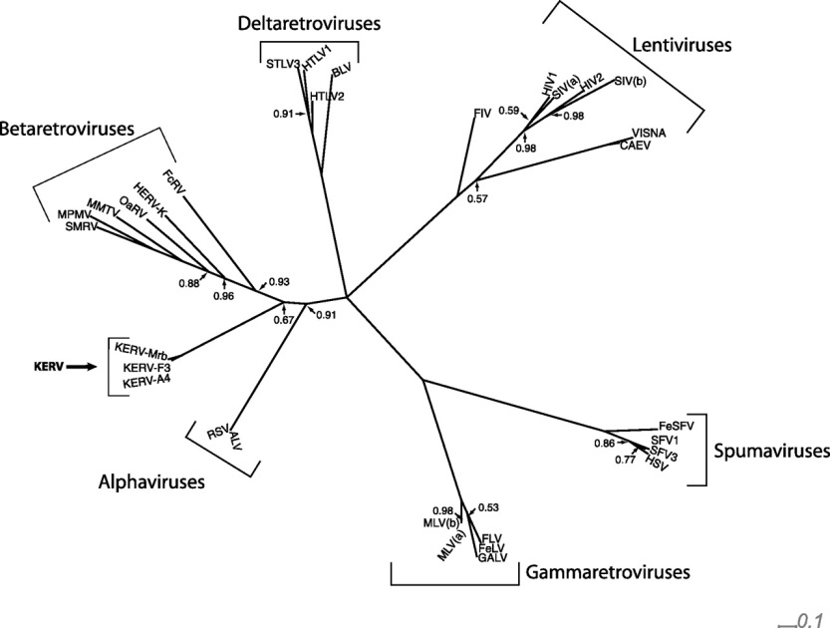
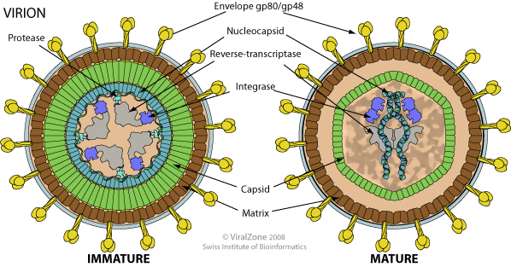
RNA retroviruses
Spumaviruses
• Different from the lentiviruses and
other retroviruses in their structure,
replication, and genetics
- Has prominent spikes and a
strange looking capsid
- Buds into the ER (not PM)
- About 25% of virions will begin reverse transcription while
still outside of cells (have dsDNA)
• A few varieties can infect humans,
but no disease knonwn
- Human foamy virus (HFV)

Slide 16
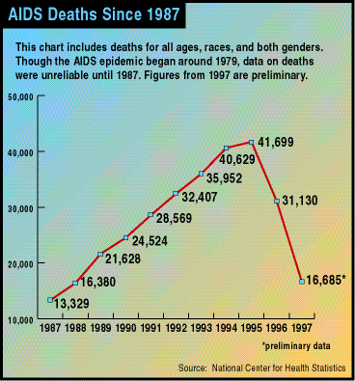
RNA retroviruses
HIV
• HIV/AIDS disease stats
- Has killed nearly 40 million people since 1980
- Currently infects nearly 80 million worldwide
- HIV continues to kill about 1.5 million people/year
- Currently worst microbial killer
- Nearly 75% of these are in sub-Saharan Africa
- Has dropped from peak of ~2-2.5 million in 2005
- Number of new HIV cases peaked in
1997 (world) and has since been declining
- Increase in anti-retroviral drugs
- Education and condom usage

Slide 17
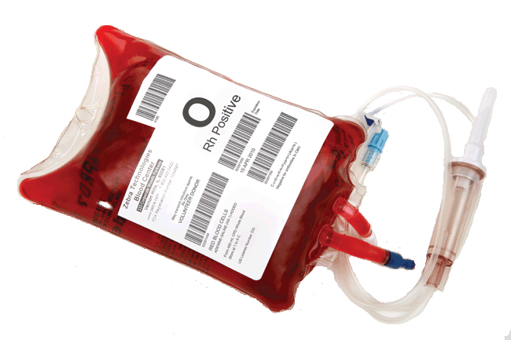
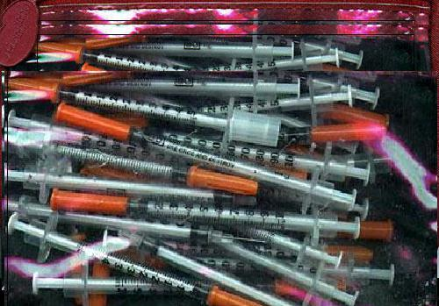
RNA retroviruses
HIV
• HIV mode of transmission
- Fragile virus that only infects humans → transmitted
person-to-person
- All transmission involves the transfer of infected body fluids
- Major modes of transmission:
1) Sexual intercourse (semen/vaginal secretions)
- Most common, mostly heterosexual worldwide
2) Blood transfusion (blood)
- Very rare since 1985 (blood screening)
3) Injected during IV drug use (blood)
- Shared needles/syringes
4) Vertically (blood, breast milk)
- Crossing of the placenta?, during birth, or during breast
feeding → W/o anti-retrovirals, baby at great risk

Slide 18

RNA retroviruses
HIV
• HIV mode of transmission
- Workplace exposure (blood)
- Medical workers exposed to infected blood via
accidental needle sticks or splash to eyes/mouth
- If exposed, <0.5% become infected
- Infected medical workers rarely pass onto patients
- Case of dentist David Acer and his patient Kim
Bergalis (FL)
- Prostitutes/porn workers
- In some African countries, nearly 40% have HIV
- Almost 10x more likely to get HIV than rest of
population

Slide 19
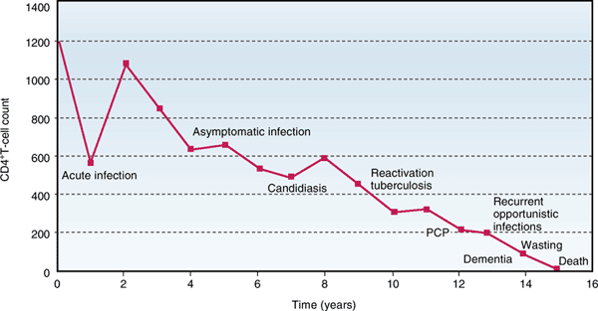
RNA retroviruses
HIV
• HIV progression and disease symptoms
- HIV initially causes an acute infection by 24 weeks post-
infection
- Most cases → fever and sore throat
- Immune system recovers and destroys most virions
- Clinical latency follows → months – 15 yrs
- Skin issues (dermatitis, eczema, psoriasis)
common early on
- As T_{H} cell counts drop (<600
cells/mL), characteristic
symptoms of AIDS observed

Slide 20
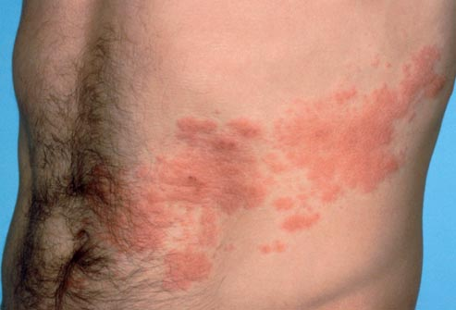
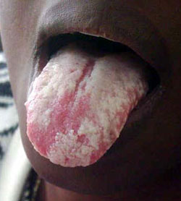
RNA retroviruses
HIV
• HIV progression and disease symptoms
- "Reactivation" of chronic infections
- HSV (cold sores), EBV (hairy leukoplakia), CMV
(various), VZV (zoster), TB
- Recurrent yeast/fungal infections
- Oral/vaginal Candida (thrush)
- Pneumocystis pneumonia (P. carinii)
- Gastrointestinal illnesses
- Great susceptibility to bacteria, fungi, and
protozoa that cause diarrhea
- Ex: Salmonella, Shigella, Giardia, Cryptosporidium

Slide 21
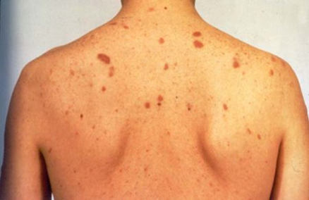
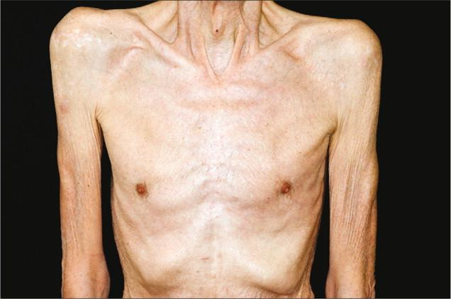
RNA retroviruses
HIV
• HIV progression and disease symptoms
- Cancers
- Kaposi's sarcoma (skin cancer) caused by HHV8
- Variety of lymphomas (B and T cell)
- Central nervous system destruction
- HIV directly infects and destroys various CNS cells
- Many often develop brain cancers and/or brain infections
- End result: Severe inflammation and dementia very
common
- Chronic wasting
- Unknown mechanism – progressive weight loss

Slide 22
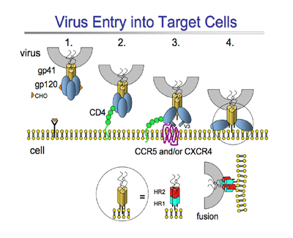
RNA retroviruses
HIV
• HIV replication
- Attachment and entry
- HIV primarily targets two types of cells initially
- T_{H} cells and macrophages
- Requires presence of CD4 (primary receptor) and one of
several co-receptors (CCR5 and CXCR4 are most
common)
- Different strains of HIV use different co-receptors
- R5 strain – prefers CCR5, targets high levels of
macrophages and T cells, usually early in infection
- Called macrophage tropic
- X4 strain – prefers CXCR4, see later in infection,
targets most T cells, usually later in infection
- Called T-cell tropic

Slide 23
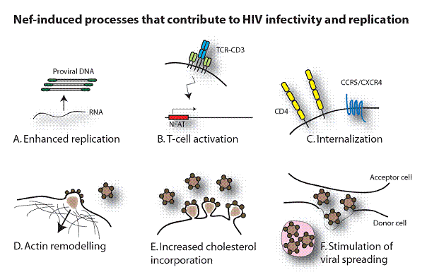
RNA retroviruses
HIV
• HIV replication
- Attachment and entry
- After HIV enters, it prevents additional virions from
attaching using its Nef protein
- HIV Nef functions
- Binds to surface CD4 and pulls it into inside of cell
- Internalizes MHC on
surface
- Prevents immune cell
activation
- Increases cholesterol
content (lipid rafts)
- Changes cytoskeleton

Slide 24
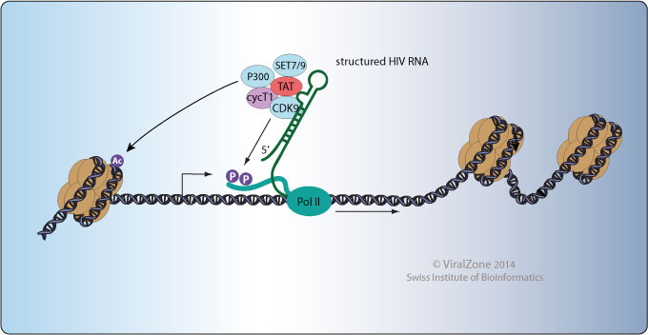
RNA retroviruses
HIV
• HIV replication
- Gene expression and genome replication
- Transcription of viral genes uses host RNA pol and
several host transcription factors (TFs)
- Bind to promoters in HIV LTR
- HIV Tat protein enhances HIV transcription
- Binds to HIV RNA that is in the process of being made
and stabilizes it
- Gives host RNA pol time to
finish transcription
- Acts an HIV-specific TF
- Unique as a RNA binding TF

Slide 25
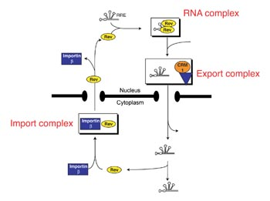
RNA retroviruses
HIV
• HIV replication
- Gene expression and genome replication
- Viral mRNAs are capped, polyadenylated, and sent
out of the nucleus
- Major problem with full-length HIV mRNAs
- Looks like it has introns w/in it
- Nuclear pore doesn’t want to let it out
- HIV Rev protein goes into the nucleus
and attaches to the unspliced HIV
mRNAs
- Escorts those mRNAs out through
the pore

Slide 26
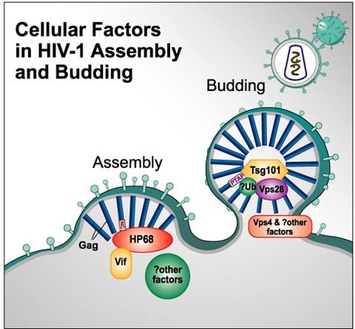
RNA retroviruses
HIV
• HIV replication
- Assembly and budding
- HIV Gag polyproteins clump up together on the plasma
membrane at lipid rafts
- Aggregation pushes membrane out → budding starts
- Process enhanced by several
other HIV accessory proteins
- Vif – blocks inhibitory cellular
proteins from getting packaged
- So RT works well at entry
- Vpu – loosens budding proteins
so viruses don’t stay stuck on PM

Slide 27

RNA retroviruses
HIV
• HIV is very good at hiding from the immune response
- Downregulation of class I/II MHC and CD4
- HIV Nef and Vpu binds to each of the above on the
plasma membrane and triggers internalization
- T cells can’t be activated
- Kills T_{H} cells and inactivates macrophages
- Creates ineffective innate and adaptive immune responses
- Hides in macrophages and stem cells
- Infects them and produces low levels of viral products
- Creates a stable reservoir of virus

Slide 28
RNA retroviruses
HIV
• HIV is very good at hiding from the immune response
- Reverse transcriptase creates lots of mutations
- Surface proteins constantly change so that immune
system no longer recognizes
- Low immunogenecity of most HIV products (except
gp120)
- HIV MA, NC, CA, etc are largely ignored by host
immune system
- Virions express very low levels of gp120 and gp41 on their
surface (only 14 spikes per virion)

Slide 29
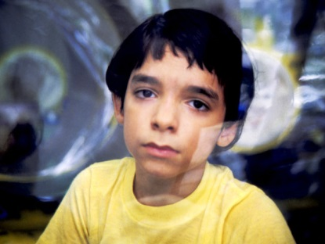
RNA retroviruses
Retroviruses as viral vectors
• Retroviruses are commonly use to deliver genes to cells
- Advantages
- They permanently integrate themselves into the host
genome
- No risk of losing the added gene
- High levels of expression (promoters in LTRs are very
active)
- Disadvantages
- Still can’t control where the viral genome integrates
- Bad integration can inactivate virus or cause
dangerous situation for the host

Slide 30
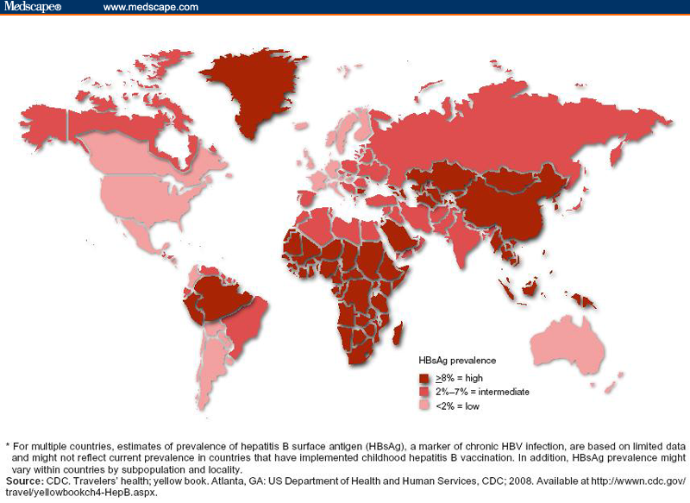
Hepadnaviruses
Overview
• Named because they cause hepatitis and are DNA viruses
- Infects mammals and some birds
• Most common one in humans is the hepatitis B virus (HBV)
• HBV is found all over the world
- Most common in Asia, Africa,
and parts of S. America
- Infects about 350 million in
world
- About 50 million new
infections per year

Slide 31
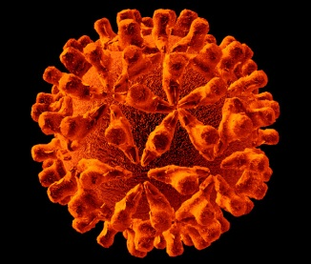
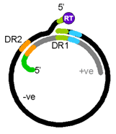
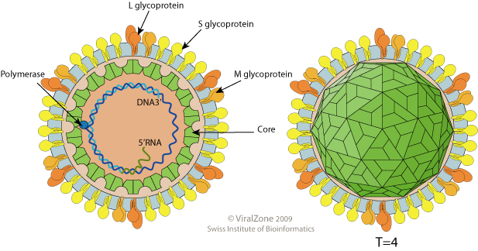
HBV
Genome and virion structure
• Genome is partly ssDNA, partly dsDNA
- Even has a short section that is triple helix
- 5’ end of each strand is bound to something
- One has polymerase protein (RT)
- One has a piece of RNA attached (serves as cap)
- 4 genes → 7 proteins (in just 3,200 nt)
• Icosahedral capsid that has holes
and spikes protruding
- Surrounded by envelope
- Has 3 glycoproteins (S, M, L)
- Collectively called surface Ag
- No matrix

Slide 32
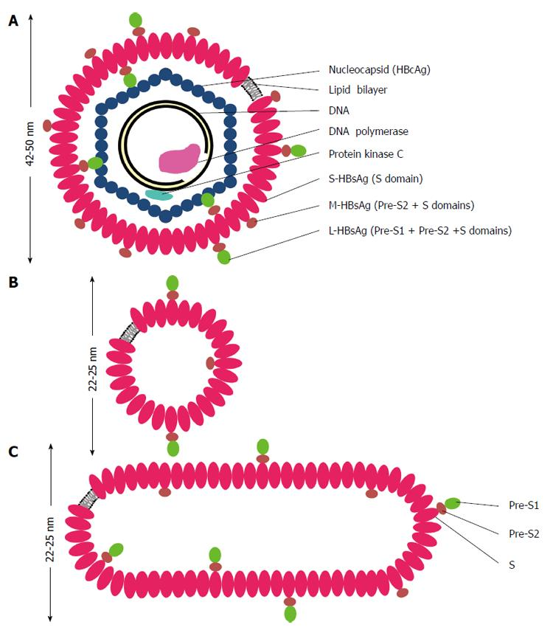
HBV
Noninfectious particles
• HBV makes an enormous amount of noninfectious particles
that get released into blood of infected
- Outnumber virions by far
- Purpose: Possibly to act as a decoy
for host antibodies
- Composed of only membrane and
glycoproteins (no nucleocapsid)
- Opposite of most VLPs
- Two major shapes seen – spherical
and filamentous
• HBV vaccine is just HBsAg that was
made in yeast cells

Slide 33
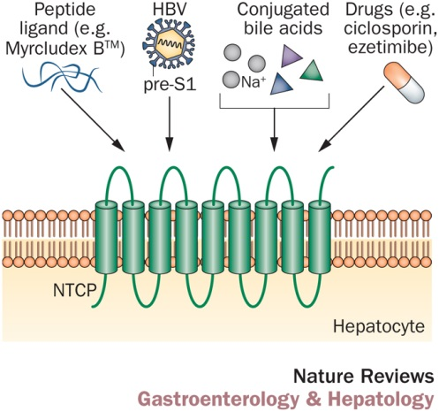

HBV
Replication
• HBV attachment was not understood until recently
- Virus very specific for hepatocytes
- Receptor was unknown
- Found to be a bile acid receptor called
NTCP in 2012
- Only on liver cells
• Entry and uncoating
- Enters via endocytosis → endosome escape
- Moves to nucleus as intact capsid and enters
the nuclear pore
- Uncoats w/in the nuclear pore → only genome
is released

Slide 34
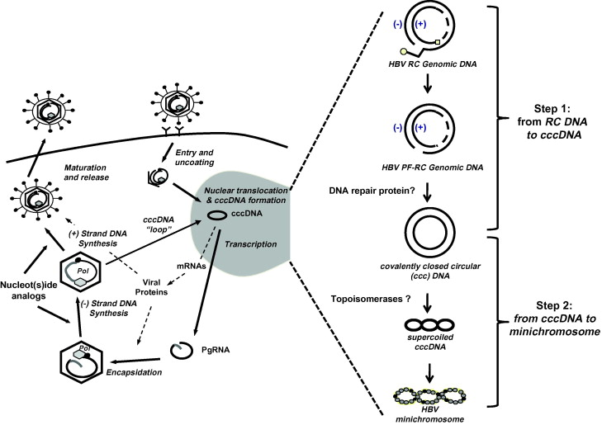
HBV
Replication
• Released genome undergoes changes while in nucleus
- RNA cap and RT get cut off
- Host DNA pol finish the partial dsDNA into being fully ds
- All pieces get glued together
- Final circular, dsDNA is
called cccDNA
- Host topoisomerase turns
loose circular DNA into
supercoiled DNA
- Can persist in nucleus
for a long time

Slide 35
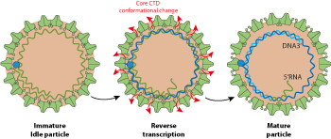
HBV
Replication
• Fully dsDNA from HBV is transcribed by host RNA pol
- Uses transcription factors only expressed in liver cells
- Can just add receptor to cell and make it permissive
- All HBV mRNAs (+ sense RNA) made are capped and
given a poly A tail
- Some are full length and others shorter (for translation)
• Nucleocapsid assembly occurs in the nucleus and budding
occurs at the ERGIC membrane
- One single copy of + sense HBV
genome is packaged
• As nucleocapsids start egress, reverse transcription begins
- Doesn’t finish 2nd strand b/c it runs out of nucleotides

Slide 36
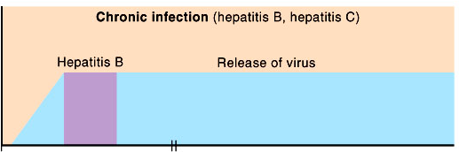
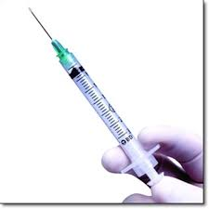
HBV
Pathogenesis
• HBV is transmitted in the same way as HIV
- Sexual contact, shared blood (e.g. needles), breastfeeding
• From blood, HBV virions go to the liver and infect
hepatocytes
- Virus replicates and spreads throughout the liver
• Establishes a long-term persistent infection
- More likely if exposed to HBV as a kid (90%)
- Rare for adults infected for 1st time
• HBV usually doesn’t kill the hepatocyte
- Almost all death due to T_{c} cell killing of infected cells

Slide 37
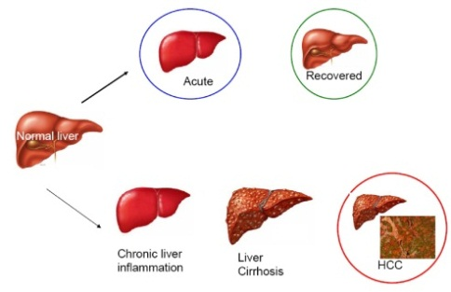
HBV
Pathogenesis
• HBV liver infection can produce serious long-term illness
- Liver cirrhosis
- Due to chronic inflammation over many years
- Gradual build-up of damage over time
- Liver failure results
- Heptocellular carcinoma
- Deadly liver cancer
- Mechanism not fully understood
- No clear oncogenes
- Some evidence that parts of HBV
genome may integrate into host
- May insert near cell division gene

